Slide 1
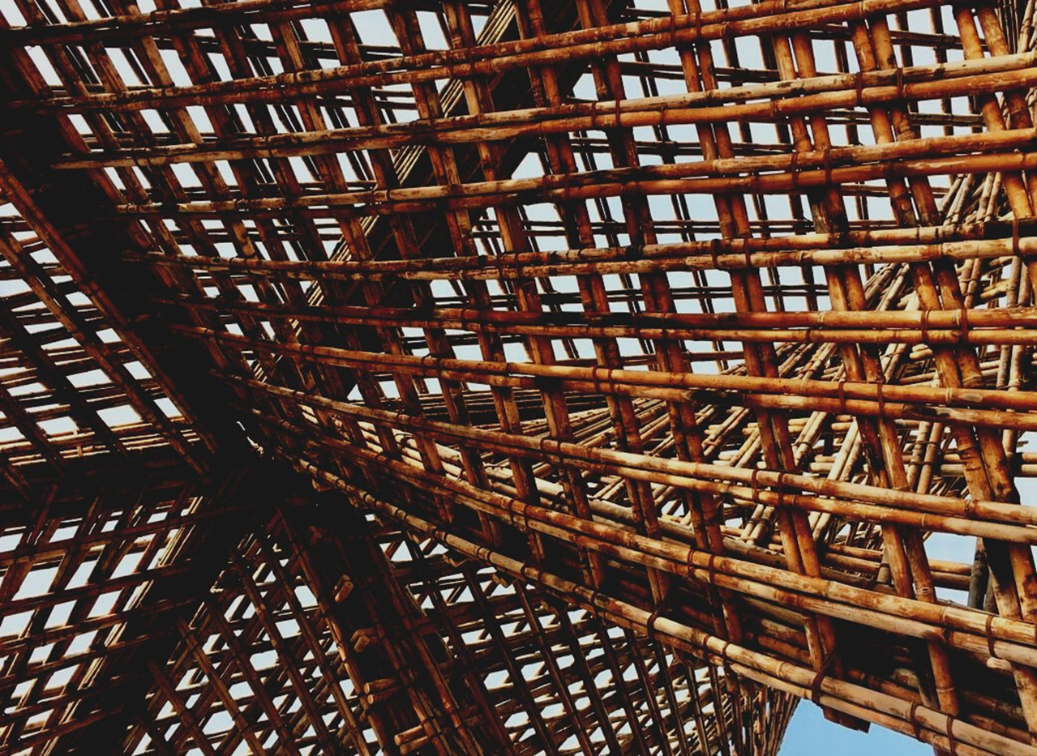
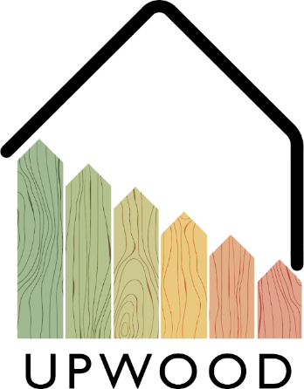
LEARNING UNIT 4: Functionality and efficiency of wooden buildings / Learning unit 4 (LU4)
Lesson 1:
Energy-efficiency value of wood as a building material and wooden constructions.
Presentation

Slide 2
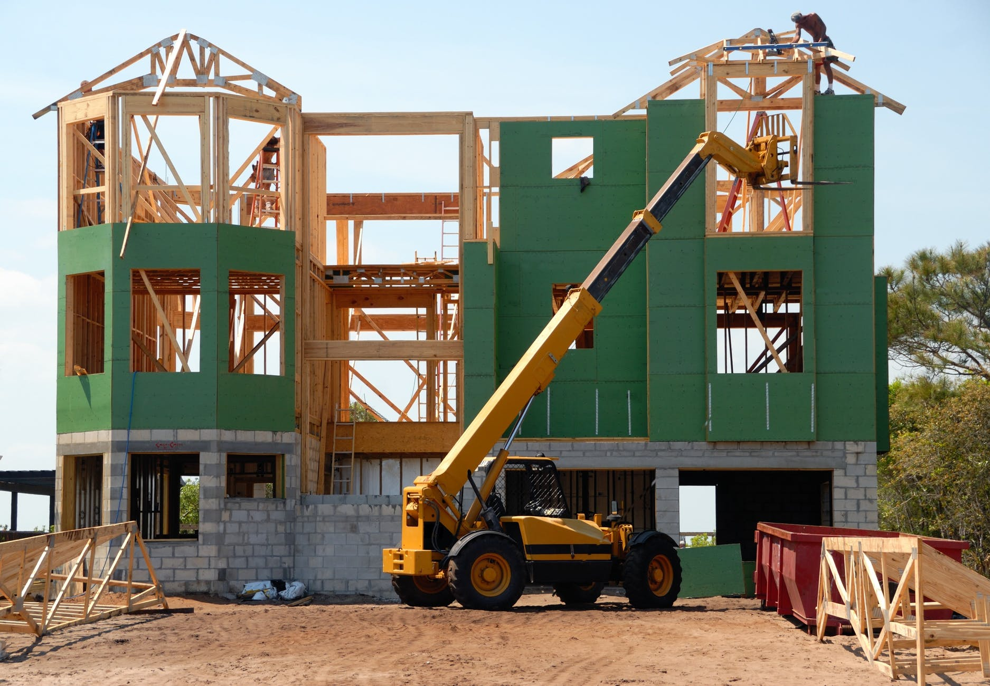
Presentation Overview
TOPICS DISCUSSED
- Thermal transmittance Principles
- Thermal insulation
- Thermal bridges
- Energy Efficiency Certificates
LESSON 1: Energy-efficiency value of wood as a building material and wooden constructions.

Slide 3
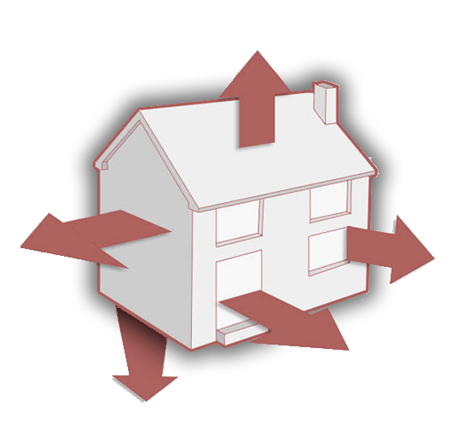
THERMAL TRANSMMITTANCE PRINCIPLES
it is important to understand the behaviour of materials in terms of heat transfer. These values will be useful to calculate heat loss of all opaque parts of the building, and to be able to design each enclosure system of the building, considering roofs, horizontal partitions, vertical partitions, façade walls, and even every façade opening, for the sake of avoiding as much heat loss as possible.
For the better understanding of this thermal principles, it is important to check terms such as:
Heat energy, Thermal conductivity (k) or (λ), Coefficient of thermal conductance “ λ” , Thermal resistivity, Thermal resistance (R-value), Coefficient of heat transmission (U), Permeance to water vapour (pv), or Resistance to water vapour (rv).
3
LESSON 1: Energy-efficiency value of wood as a building material and wooden constructions.

Slide 4
Concepts
SAFETY RULES AND REGULATIONS
Thermal resistivity is the reciprocal of the k-value (1/k)
Heat energy is is the amount of heat (energy) needed to raise the temperature of one kg of water by one degree Celsius (°C).
The thermal resistance (R-value) is the reciprocal of l (1/l) and is used for calculating the thermal resistance of any material or composite material. R-value can be defined in simple terms as the resistance that any specific material offers to the heat flow.
Thermal conductivity (k) or (λ) is a measure of the capacity of a material to conduct heat through its mass.
Coefficient of thermal conductance “λ” is defined as the amount of heat (in kcal) conducted in one hour through 1 m2 of material, with a thickness of 1 m, when the temperature drop through the material under conditions of steady heat flow is 1 °C.
Coefficient of heat transmission (U) designates the overall coefficient of heat transmission for any section of a material or a composite of materials. It is inversely proportional to the value of Total Thermal Resistance (RT) of a given wall solution
LESSON 1: Energy-efficiency value of wood as a building material and wooden constructions.

Slide 5
THERMAL INSULATION MATERIALS
The control of thermal transmittance of the chosen materials for the project is crucial in order to ensure the minimum heat loss through the building enclosures.
Thermal insulation is defined as the reduction of heat transfer (the transfer of thermal energy between objects of differing temperature) between objects in thermal contact.
For that reason, aside of using the best constructive system, the choice of an adequate insulation and its adequate disposition is one of the most important topics to reach the lowest heat losses.
All insulation materials can be listed in two groups: Organic and Inorganic materials, being this second one the most used, and the organic the most friendly with the environment
5
LESSON 1: Energy-efficiency value of wood as a building material and wooden constructions.

Slide 6
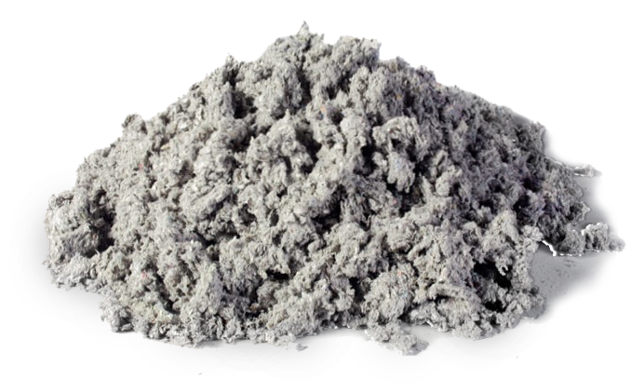
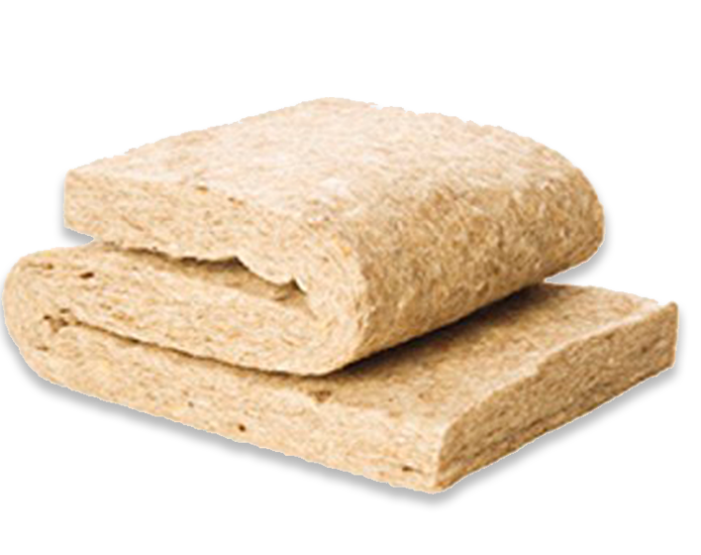
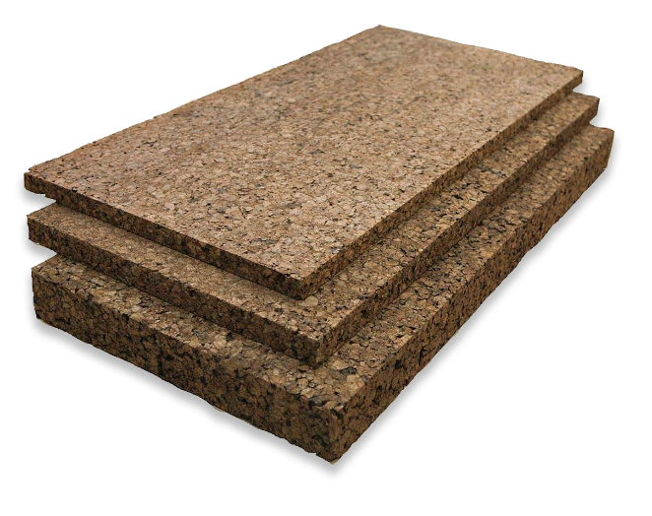
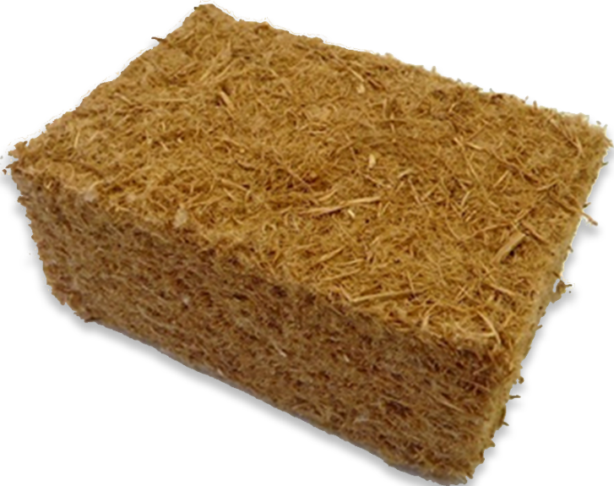
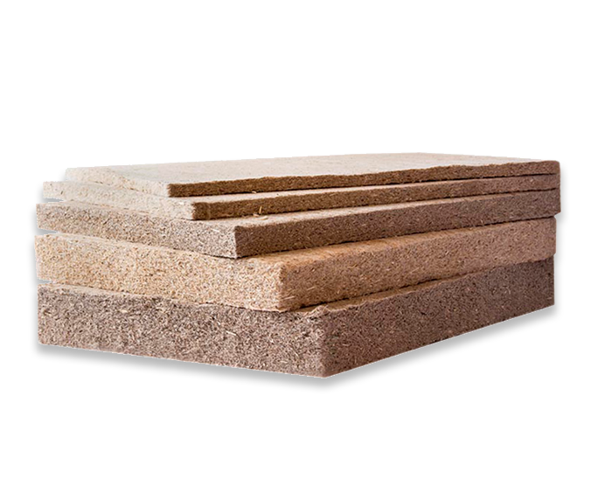
Natural Insulation materials
Celulose / Paper fibres
Sheepwool
Some of the most eco-friendly materials with as good insulating properties as the most commonly used are cellulose, sheep natural wool, wood fiber or even natural cork. These insulations are becoming popular due to their nice insulation properties:
Natural cork
Wood fibre insulation.
Hemp Insulation
LESSON 1: Energy-efficiency value of wood as a building material and wooden constructions.

Slide 7
Benefits of natural insulations
SUSTAINABILITY
INSULATION PROPERTIES
Ecological insulations made from organic and natural materials, with very low energetic requirements for its production.
The thermal conductivity (λ) of most of organic insulations is below 0.04 W/(m·K), which is a great feature.
ADAPTABILITY
HYGROSCOPIC PROPERTIES
Most of the organic insulation elements are not rigid, which provides great versatility and adaptability to the surfaces to cover.
Most of natural organic insulations present good hygroscopic properties, regulating the humidity levels inside buildings.
LESSON 1: Energy-efficiency value of wood as a building material and wooden constructions.

Slide 8
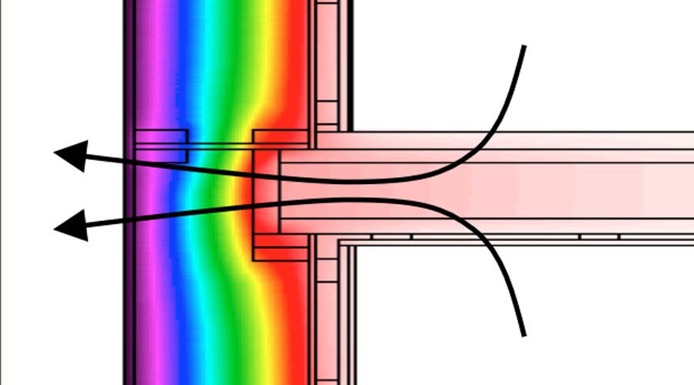
THERMAL
BRIDGES
Thermal bridges are sensible parts of the building where there is a variation in the uniformity of the construction. This variation can be caused by a different thickness of the enclosure or the characteristics of the materials used, the penetration of constructive elements with varying conductive properties or the difference between external and internal area, (like walls , floors or roofs).
8
LESSON 1: Energy-efficiency value of wood as a building material and wooden constructions.

Slide 9
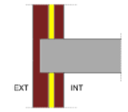
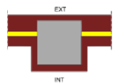
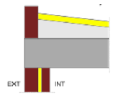
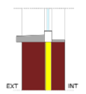
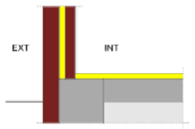
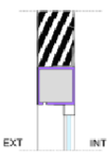
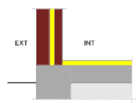
Weak Points
SAFETY RULES AND REGULATIONS
- Front slab in façades
- Pillars Integrated in the enclosure of the facade
- Joints between facades and roofs
- Perimeter of holes and skylights
- Joints between facades and enclosures in contact with soil
- Blind boxes
- Joints of the façade with slab
- Other integrated thermal bridges.
- Joint of the façade with underground walls.
LESSON 1: Energy-efficiency value of wood as a building material and wooden constructions.

Slide 10
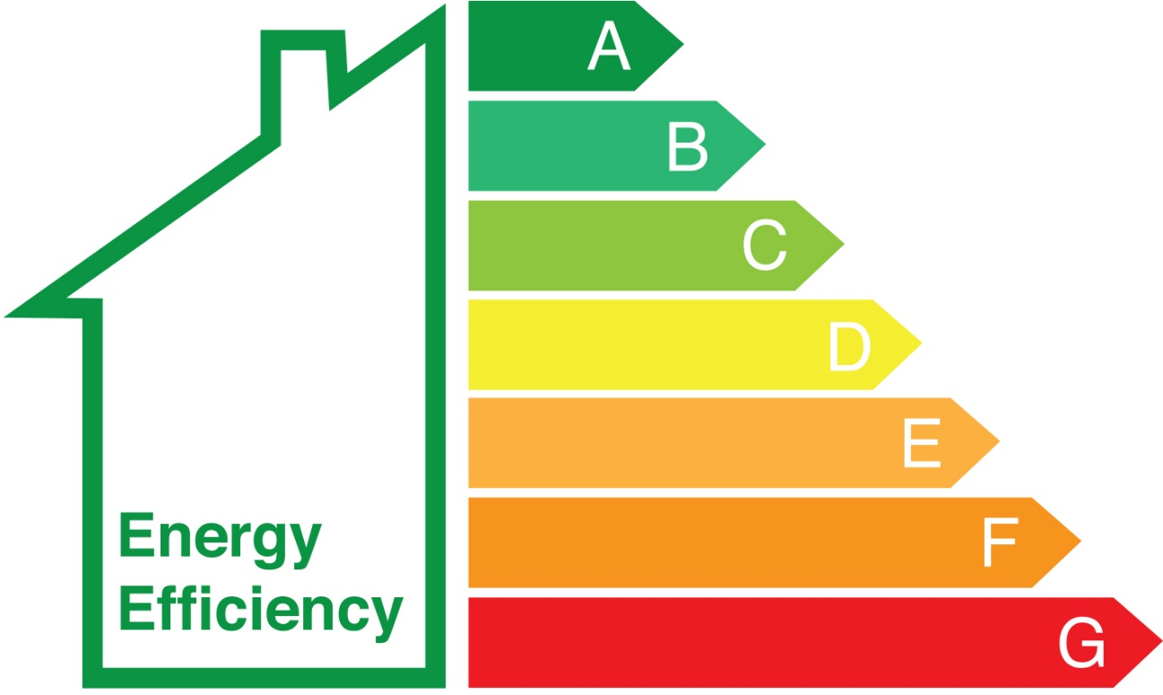
ENERGY EFFICIENCY CERTIFICATES
Different aspects should be taken in account regarding building’s energy consumption, technical and administrative conditions should be established for the release of the certification, and a common framework should be set in all the national territory in the form of an energy efficiency label.
Knowing the Energy Efficiency of a buildings means to have the value of the energy consumption needed by the building to satisfy the energetic demand in normal conditions of occupancy and use.
10
LESSON 1: Energy-efficiency value of wood as a building material and wooden constructions.

