Slide 1
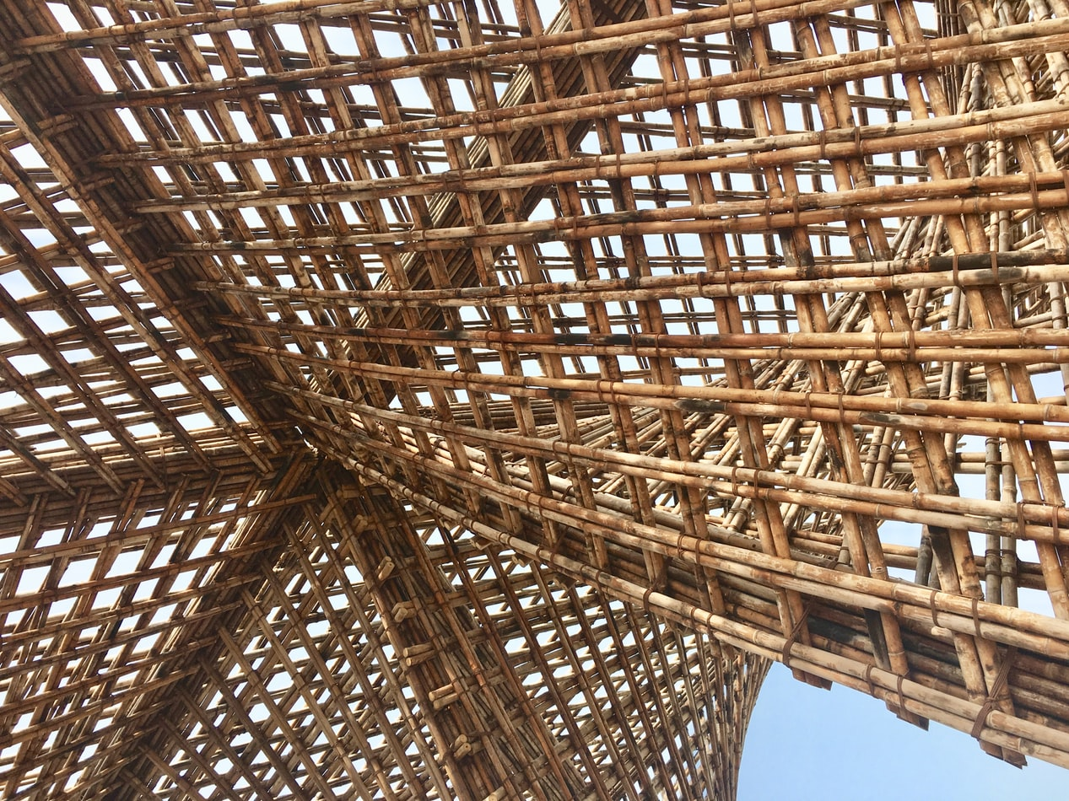
UNIT 3:
Lesson 7
Thermal insulation materials

Slide 2
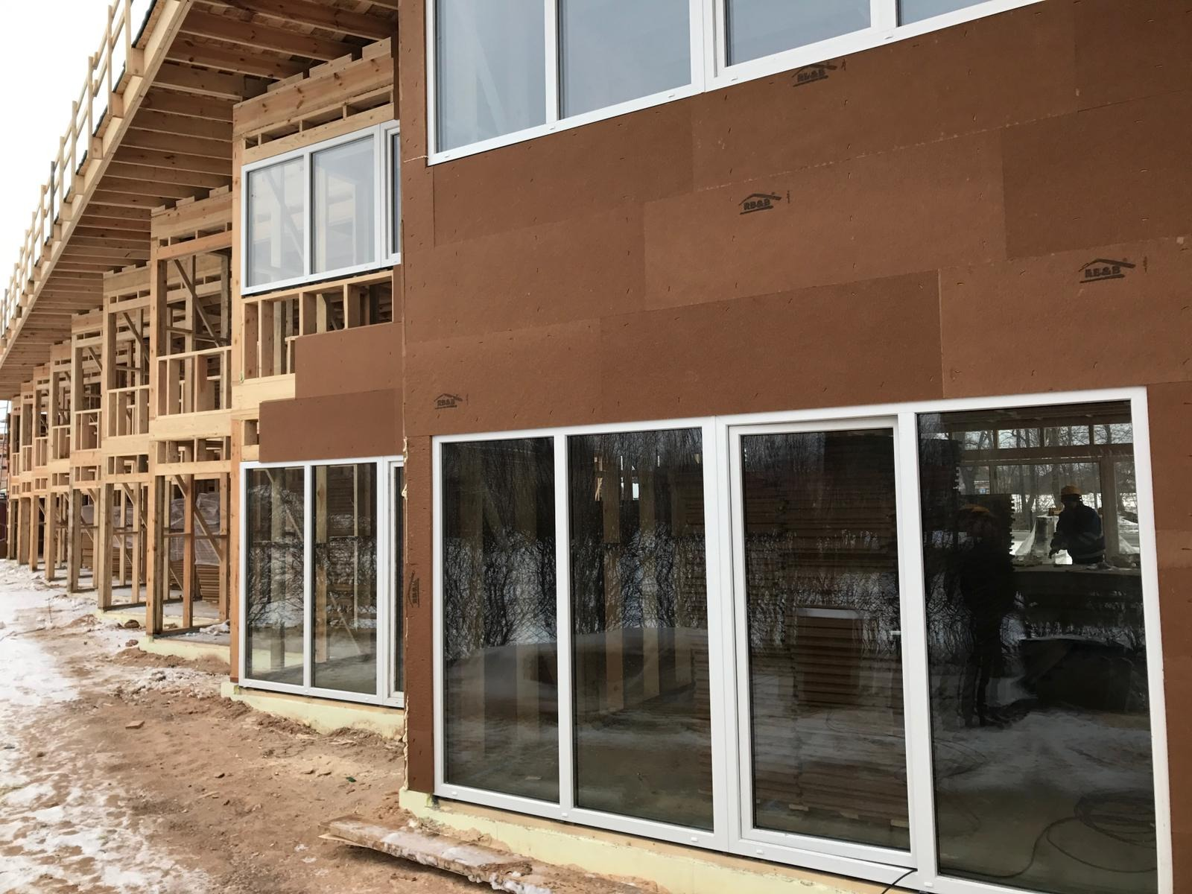
Presentation Overview
TOPICS DISCUSSED
Introduction of heat insulation material properties
Why insulation is necessary
Materials, accessible in insulation market
Common insulating materials, “K” values, advantages and disadvantages
Examples in practice
LESSON 7: Thermal insulation materials

Slide 3
Heat insulation materials
Thermal conductivity (k-value) is a measure of the capacity of a material to conduct heat through its mass.
Coefficient of thermal conductance “λ” is defined as the amount of heat (in kcal) conducted in one hour through 1 m² of material, with a thickness of 1 m, when the temperature drop through the material under conditions of steady heat flow is 1 °C.
Thermal resistivity is the reciprocal of the k-value (1/k).
Thermal resistance (R-value) is defined in simple terms as the resistance that any specific material offers to the heat flow.
Coefficient of heat transmission (U) designates the overall coefficient of heat transmission for any section of a material or a composite of materials.
DEFINITION OF TERMS
3
LESSON 7: Thermal insulation materials

Slide 4
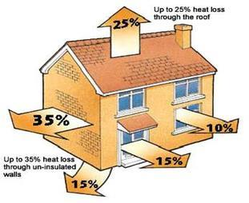
Benefits of Heat insulation in buildings
1. Reduces the transmission of heat through building walls
2. Reduction of CO² emissions
3. Energy Efficiency with Thermal Insulation
4. Stronger and Longer - Lasting Buildings
5. Positive Effect on Human Health
6. Environment and Ecological Balance
7. Helping Sound Insulation
8. Contribution to National and Family Economy
4
LESSON 7: Thermal insulation materials

Slide 5
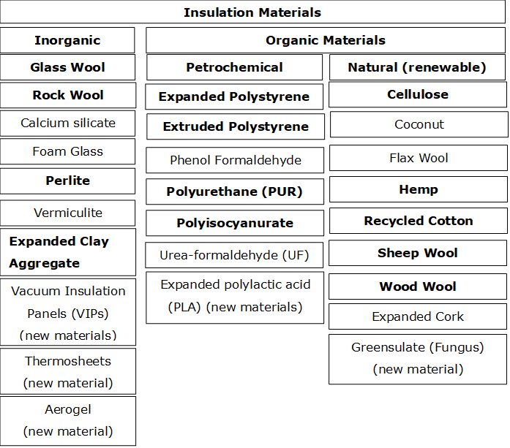
4. Materials accessible in the insulation market
LESSON 7: Thermal insulation materials

Slide 6
5. Application of materials (1)
Type | Material | Where applicable | Installation methods | Advantages
Blanket: batts and rolls | Fiberglass Mineral (rock or slag) wool Plastic fibers Natural fibers | Unfinished walls, including foundation walls Floors and ceilings | Fitted between studs, joists, and beams. | Do-it-yourself. Suited for standard stud and joist spacing that is relatively free from obstructions. Relatively inexpensive.
Concrete block insulation | Foam board, to be placed on outside of wall (usually new construction) or inside of wall (existing homes): Some manufacturers incorporate foam beads or air into the concrete mix to increase R-values | Unfinished walls, including foundation walls New construction or major renovations Walls (insulating concrete blocks) | Require specialized skills Insulating concrete blocks are sometimes stacked without mortar (dry-stacked) and surface bonded. | Insulating cores increases wall R-value. Insulating outside of concrete block wall places mass inside conditioned space, which can moderate indoor temperatures. Autoclaved aerated concrete and autoclaved cellular concrete masonry units have 10 times the insulating value of conventional concrete.
Foam board or rigid foam | Polystyrene Polyisocyanurate Polyurethane | Unfinished walls, including foundation walls Floors and ceilings Unvented low-slope roofs | Interior applications: must be covered with 1/2-inch gypsum board or other building-code approved material for fire safety. Exterior applications: must be covered with weatherproof facing. | High insulating value for relatively little thickness. Can block thermal short circuits when installed continuously over frames or joists.
Insulating concrete forms (ICFs) | Foam boards or foam blocks | Unfinished walls, including foundation walls for new construction | Installed as part of the building structure. | Insulation is literally built into the home's walls, creating high thermal resistance.
LESSON 7: Thermal insulation materials

Slide 7
5. Application of materials (2)
Type | Material | Where applicable | Installation methods | Advantages
Loose-fill and blown-in | Cellulose Fiberglass Mineral (rock or slag) wool | Enclosed existing wall or open new wall cavities Unfinished attic floors Other hard-to-reach places | Blown into place using special equipment, sometimes poured in. | Good for adding insulation to existing finished areas, irregularly shaped areas, and around obstructions.
Reflective system | Foil-faced kraft paper, plastic film, polyethylene bubbles, or cardboard | Unfinished walls, ceilings, and floors | Foils, films, or papers fitted between wood-frame studs, joists, rafters, and beams. | Do-it-yourself. Suitable for framing at standard spacing. Bubble-form suitable if framing is irregular or if obstructions are present. Most effective at preventing downward heat flow, effectiveness depends on spacing.
Rigid fibrous or fiber insulation | Fiberglass Mineral (rock or slag) wool | Ducts in unconditioned spaces Other places requiring insulation that can withstand high temperatures | HVAC contractors fabricate the insulation into ducts either at their shops or at the job sites. | Can withstand high temperatures.
Sprayed foam and foamed-in-place | Cementitious Phenolic Polyisocyanurate Polyurethane | Enclosed existing wall Open new wall cavities Unfinished attic floors | Applied using small spray containers or in larger quantities as a pressure sprayed (foamed-in-place) product. | Good for adding insulation to existing finished areas, irregularly shaped areas, and around obstructions.
Structural insulated panels (SIPs) | Foam board or liquid foam insulation core Straw core insulation | Unfinished walls, ceilings, floors, and roofs for new construction | Construction workers fit SIPs together to form walls and roof of a house. | SIP-built houses provide superior and uniform insulation compared to more traditional construction methods; they also take less time to build.

Slide 8
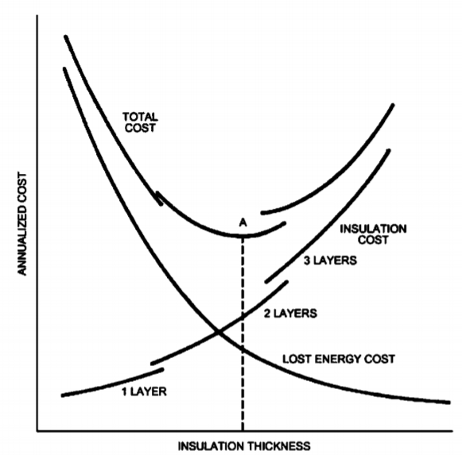
Economic Thickness of heat insulation material
8
LESSON 7: Thermal insulation materials

Slide 9
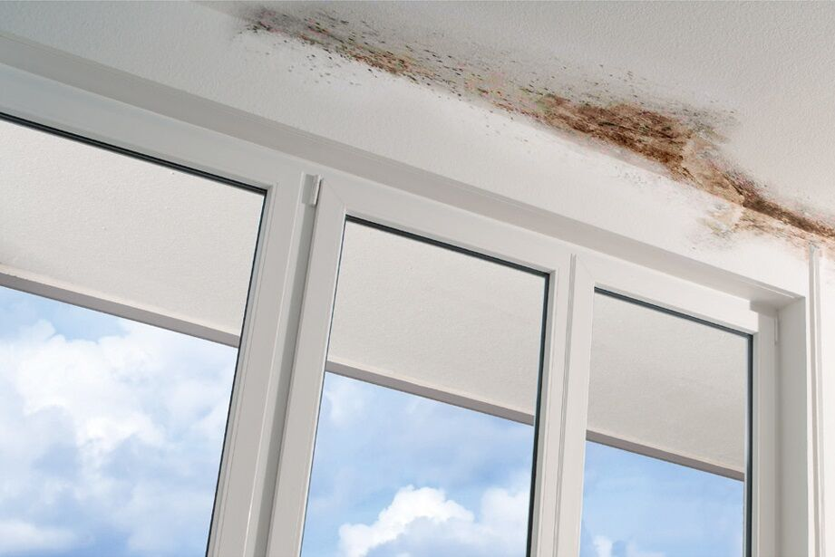
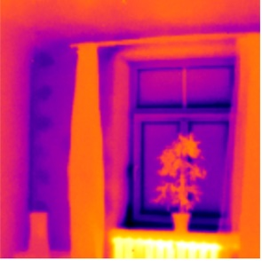
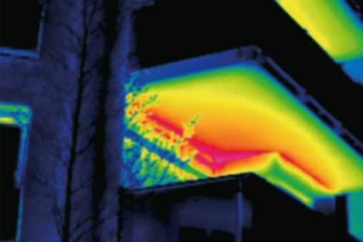
6. Faults in heat insulation systems
A thermal bridge occurs when there is a gap between materials and structural surfaces.
Integrated thermal bridges - heat insulation errors are made in design stage
9
LESSON 7: Thermal insulation materials

Slide 10
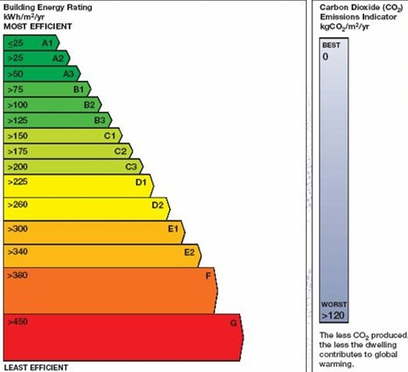
Limitations
The Passive House energy threshold of 15 kWh/(m²yr) for heating typically relates to a heating load of 10W/m² in typical Central European climates, however, it is only supposed to serve as a rough benchmark which may vary with different climatic conditions: in Stockholm a house with a heating load of 10W/m² may use more like 20kWh/(m²yr); in Rome it might be as low as 10kWh/(m²yr).
The low-energy house (LEH) proved to be a more cost-effective and simpler standard which could be implemented quickly. Low-energy houses have an annual heating demand of less than 70 kWh/(m²a) based on the living space.
10
LESSON 7: Thermal insulation materials

Slide 11
References
JOURNALS AND PUBLICATIONS
5. Ing dep (2017) Termiskie tilti (Thermal bridges). In Latvian. Accs. http://www.ingdep.lv/lv/termiskie-tilti
6. Saint Gobain Isover (2020) What is a termal bridge? Accs. https://www.isover.com/what-thermal-bridge
7. ASHRAE (2013) Handbook: Fundamentals, I-P Edition. ISBN 978-1-936504-46-6 or ISSN 1523-7230
8. Engineering tool box. Thermal Conductivity of some selected Materials and Gases. Accs. https://www.engineeringtoolbox.com/thermal-conductivity-d_429.html
Passipedia (2019) Heating load in Passive Houses. Accs. https://www.passipedia.org/basics/building_physics_-_basics/heating_load
Dylewski R. and Adamczyk J. (2011) Economic and environmental benefits of thermal insulation of building external walls. Building and Environment, Vol.46, Issue 12, December 2011, Pages 2615-2623
Building energy rating Ireland (2011) BER Certs. Accs. http://www.buildingenergyireland.ie/BERCerts.htm
1. Steico Steico.com
2. Benjamin Durakovic, Gökhan Yildiz, Mohamed E Yahia (2020) Comparative Performance Evaluation of Conventional and Renewable Thermal Insulation Materials Used in Building Envelope. ISSN 1330-3651 (Print), ISSN 1848-6339 (Online). Accs: https://hrcak.srce.hr/file/340548 DOI: https://doi.org/10.17559/TV-20171228212943
3. Climat technology centre & network (2021) Building envelope thermal insulation. Accs. https://www.ctc-n.org/technologies/building-envelope-thermal-insulation
4. Energy gov (2020) Types of Insulation. Accs. https://www.energy.gov/energysaver/weatherize/insulation/types-insulation
11
LESSON 7: Thermal insulation materials

